Slide 1
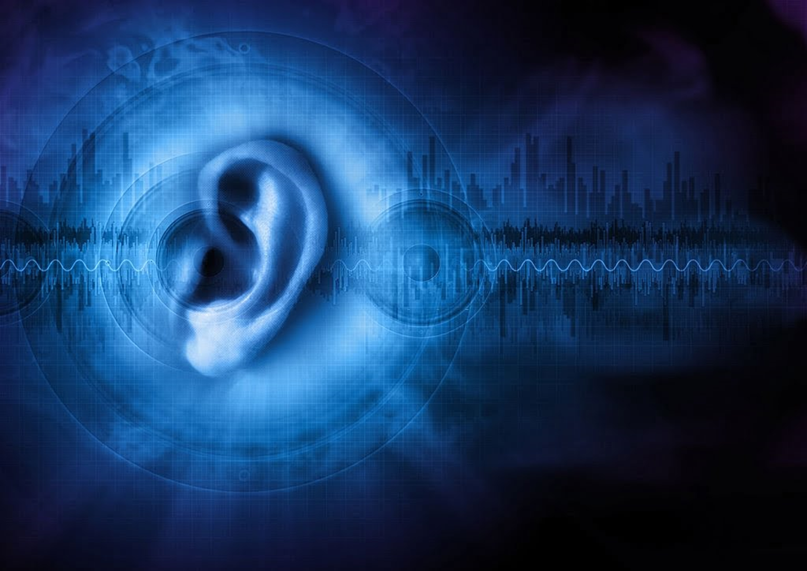
SoundSense
A Comprehensive Digital Solution for Hearing Health Assessment and Management
BY:
C.CHANDIYA
M.GOKULANJALI
R.ARTHI
A.VERONICA
AI&DS DEPT
SMVEC

Slide 2

PROBLEM STATEMENT:
To know a person Hearing Loss, generally we use a Pure Tone Audiometer. To use this it requires a bulk of the instrument to be carried. This testing requires a considerable amount of time for testing. It was observed that during a large level hearing testing it is consuming much time.
SOLUTION:
Hand held Mobile phone operated APP BASED AUDIOMETER will be of immense useful in finding and detecting the hearing loss in children and adults.

Slide 3
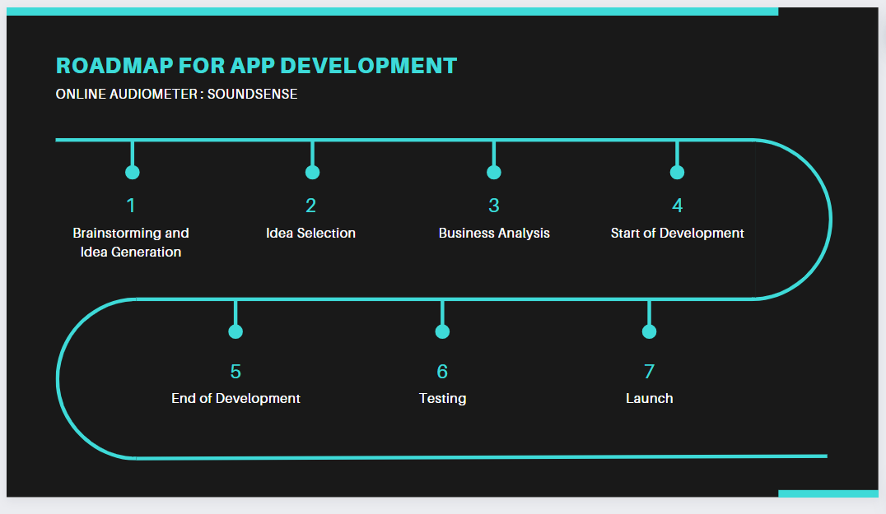

Slide 4
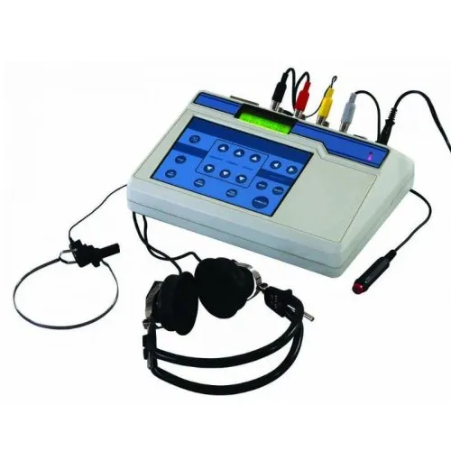
PURE AUDIOMETER(EXISTING)

Slide 5

Existing Audiometer :
Working principles
Preparation:
1. Sound-treated room or a quiet environment
2. Wearing headphones or earphones connected to the audiometer.
Calibration:
1. Ensure accurate sound levels.
Threshold Testing:
1. Presents a series of tones at various frequencies and intensities through the headphones.
2. Indicate whenever they hear a sound, often by pressing a button or raising a hand.
Air Conduction Testing:
1. Sounds are played through headphones to assess the outer, middle, and inner ear's ability to conduct sound.

Slide 6

Bone Conduction Testing:
1. A bone vibrator placed behind the ear tests the inner ear's response directly, bypassing the outer and middle ears.
Results Compilation:
1. The responses are plotted on an audiogram.
Analysis and Diagnosis:
1.Analyzes the audiogram to determine the type and degree of hearing loss.
Review and Recommendations:
1.Discusses the results with the patient.
2..Providing insights into the nature of their hearing loss.
3. Provides medical treatment, hearing aids, or other interventions.

Slide 7

Features of SoundSense
Hearing Test Functionality:
Provide an easy-to-use, accurate hearing test that users can take directly from their smartphones or using web integration.
Utilize calibrated sound levels to ensure the test's reliability across different devices.
Results Interpretation and Recommendations:
Automatically interpret test results to categorize hearing capacity (e.g., normal, moderate loss, severe loss).
Offer personalized recommendations based on the test outcomes.
Maintenance and Prevention Tips:
For users with normal hearing, provide tips and suggestions on maintaining ear health, including noise exposure warnings, ear cleaning advice, and lifestyle modifications.

Slide 8
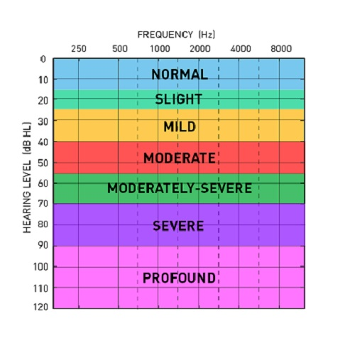

Slide 9

Features of SoundSense
Doctor Recommendations and Appointment Scheduling:
Integrate a directory of audiologists and ENT specialists with options for in-person or online consultations.
Enable appointment bookings directly from the app, facilitating user access to professional advice and treatment.
Online Consultation Platform:
Offer a secure and private online consultation feature, allowing users to connect with healthcare providers without leaving their homes.
Hearing Aid and Ear Care Products:
Partner with reputable manufacturers to offer a selection of hearing aids and ear care products like cleaning kits.
Include a virtual try-on feature for hearing aids (if feasible) and detailed product information to assist in decision-making.

Slide 10


